Slide 1
Categorical Data Analysis Project
Vinisha and Partha
Date : 19 May 2022

Slide 2
Logistic Regression
Logistic regression is used to model the probability of a certain class or event. It is used when the data is linearly separable and the outcome is binary or dichotomous in nature. That means Logistic regression is usually used for Binary Classification problems. Binary classification refers to predicting the output variable that is discrete in two classes. Eg: Pass/Fail, Yes/No, Win/Lose etc. It can be used to solve multiclass classification problems as well.

Slide 3
Logistic Regression in R with glm
We’ll study an example of a binary logistic regression, which we’ll tackle with the ISLR package, which will provide us with the data set, and the glm() function, which is generally used to fit generalized linear models, will be used to fit the logistic regression model.
We’re going to work with the Smarket dataset within RStudio. The dataset shows daily percentage returns for the S&P 500 stock index between 2001 and 2005.
A data frame with 1250 observations on the following 9 variables.
Year : The year that the observation was recorded
Lag1 : Percentage return for previous day
Lag2 : Percentage return for 2 days previous
Lag3 : Percentage return for 3 days previous
Lag4 : Percentage return for 4 days previous
Lag5 : Percentage return for 5 days previous

Slide 4
Volume : Volume of shares traded (number of daily shares traded in billions)
Today : Percentage return for today
Direction : A factor with levels Down and Up indicating whether the market had a
positive or negative return on a given day
#Exploring Data
## [1] "Year" "Lag1" "Lag2" "Lag3" "Lag4" "Lag5" ## [7] "Volume" "Today" "Direction"

Slide 5
## Year Lag1 Lag2 Lag3 Lag4 Lag5 Volume Today Direction ## 1 2001 0.381 -0.192 -2.624 -1.055 5.010 1.1913 0.959 Up ## 2 2001 0.959 0.381 -0.192 -2.624 -1.055 1.2965 1.032 Up ## 3 2001 1.032 0.959 0.381 -0.192 -2.624 1.4112 -0.623 Down ## 4 2001 -0.623 1.032 0.959 0.381 -0.192 1.2760 0.614 Up ## 5 2001 0.614 -0.623 1.032 0.959 0.381 1.2057 0.213 Up ## 6 2001 0.213 0.614 -0.623 1.032 0.959 1.3491 1.392 Up

Slide 6
## Year Lag1 Lag2 Lag3 ## Min. :2001 Min. :-4.922000 Min. :-4.922000 Min. :-4.922000 ## 1st Qu.:2002 1st Qu.:-0.639500 1st Qu.:-0.639500 1st Qu.:-0.640000 ## Median :2003 Median : 0.039000 Median : 0.039000 Median : 0.038500 ## Mean :2003 Mean : 0.003834 Mean : 0.003919 Mean : 0.001716 ## 3rd Qu.:2004 3rd Qu.: 0.596750 3rd Qu.: 0.596750 3rd Qu.: 0.596750 ## Max. :2005 Max. : 5.733000 Max. : 5.733000 Max. : 5.733000
## Lag4 Lag5 Volume Today ## Min. :-4.922000 Min. :-4.92200 Min. :0.3561 Min. :-4.922000 ## 1st Qu.:-0.640000 1st Qu.:-0.64000 1st Qu.:1.2574 1st Qu.:-0.639500 ## Median : 0.038500 Median : 0.03850 Median :1.4229 Median : 0.038500 ## Mean : 0.001636 Mean : 0.00561 Mean :1.4783 Mean : 0.003138 ## 3rd Qu.: 0.596750 3rd Qu.: 0.59700 3rd Qu.:1.6417 3rd Qu.: 0.596750 ## Max. : 5.733000 Max. : 5.73300 Max. :3.1525 Max. : 5.733000 ## Direction ## Down:602 ## Up :648

Slide 7
We can see that there’s a number of lags, volume, today’s price, and direction. We will use Direction as a response variable, as that shows whether the market went up or down since the previous day.
Visualizing Data
It’s extremely hard to see, but most of the variables show a Gaussian or double Gaussian distribution.

Slide 8
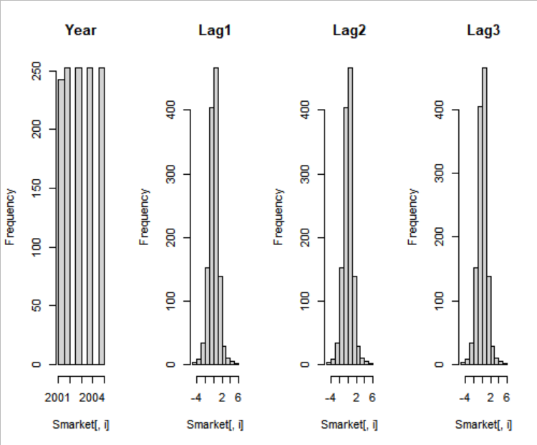

Slide 9
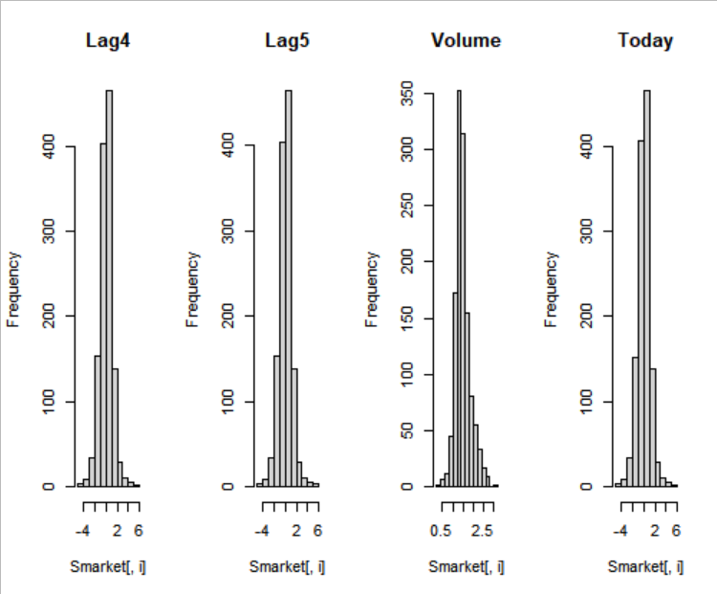

Slide 10
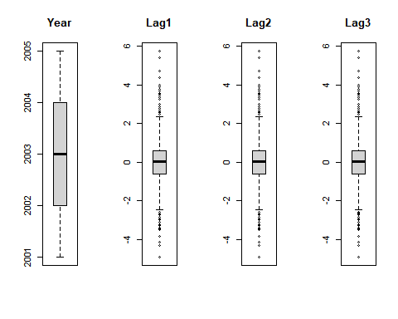
We can look at the distribution of the data a different way using box and whisker plots. The box captures the middle 50% of the data, the line shows the median and the whiskers of the plots show the reasonable extent of data. Any dots outside the whiskers are good candidates for outliers.

Slide 11
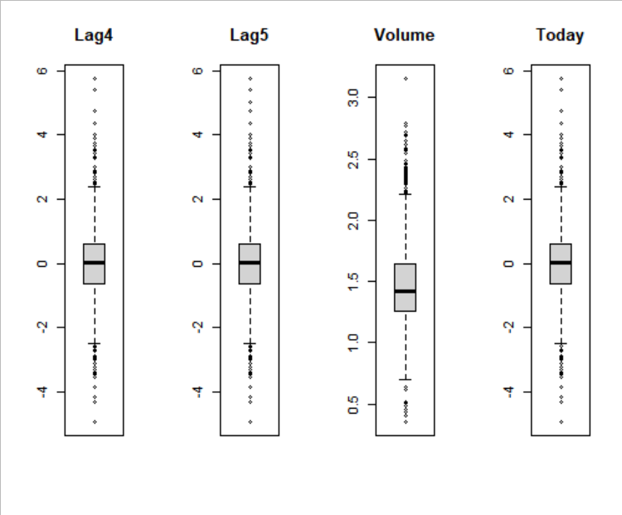
We can see that the Lags and Today all has a similar range. Otherwise, there’s no sign of any outliers.

Slide 12
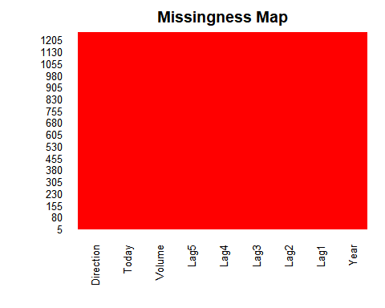
Checking for missing Data Missing data have have a big impact on modeling. Thus, we can use a missing plot to get a quick idea of the amount of missing data in the dataset. The x-axis shows attributes and the y-axis shows instances. Horizontal lines indicate missing data for an instance, vertical blocks represent missing data for an attribute.
There is no missing data in this dataset

Slide 13
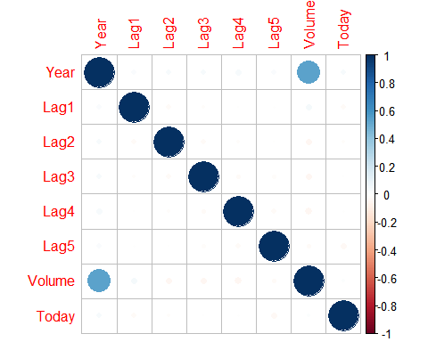
Now, we’ll calculate the correlation between each pair of numeric variables. These pair-wise correlations can be plotted in a correlation matrix plot to given an idea of which variables change together.
A dot-representation was used where blue represents positive correlation and red negative. The larger the dot the larger the correlation. You can see that the matrix is symmetrical and that the diagonal are perfectly positively correlated because it shows the correlation of each variable with itself. None of the variables are correlated with one another.

Slide 14
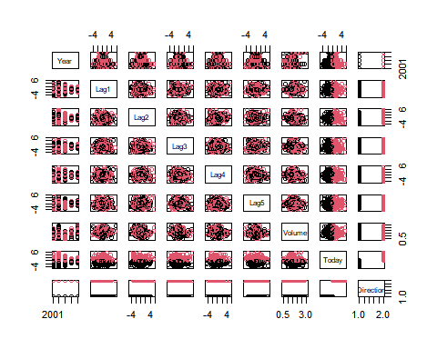
Now, we’ll make a plot of the data using pairs() function which plots the variables in Smarket into a scatterplot matrix. In this case, Direction, your binary response, is the color indicator:
It looks like there’s not much correlation going on here. The class variable is derived from the variable Today, so Up and Down seems to make a division. Other than that, there’s not much going on.

Slide 15
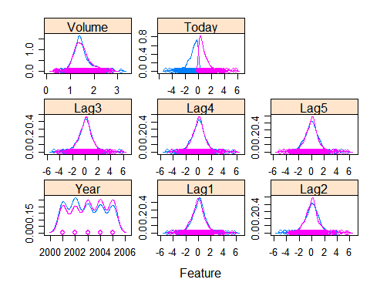
Let’s take a look at the density distribution of each variable broken down by Direction value. Like the scatterplot matrix above, the density plot by Direction can help see the separation of Up and Down. It can also help to understand the overlap in Direction values for a variable.
We can see that the Direction values overlap for all of these variables, meaning that it’s hard to predict Up or Down based on just one or two variables.

Slide 16
Logistics Regression
## Call: ## glm(formula = Direction ~ Lag1 + Lag2 + Lag3 + Lag4 + Lag5 + ## Volume, family = binomial, data = Smarket) ## ## Deviance Residuals: ## Min 1Q Median 3Q Max ## -1.446 -1.203 1.065 1.145 1.326 ## ## Coefficients: ## Estimate Std. Error z value Pr(>|z|) ## (Intercept) -0.126000 0.240736 -0.523 0.601 ## Lag1 -0.073074 0.050167 -1.457 0.145 ## Lag2 -0.042301 0.050086 -0.845 0.398 ## Lag3 0.011085 0.049939 0.222 0.824 ## Lag4 0.009359 0.049974 0.187 0.851 ## Lag5 0.010313 0.049511 0.208 0.835 ## Volume 0.135441 0.158360 0.855 0.392 ## ## (Dispersion parameter for binomial family taken to be 1) ## ## Null deviance: 1731.2 on 1249 degrees of freedom ## Residual deviance: 1727.6 on 1243 degrees of freedom ## AIC: 1741.6 ## ## Number of Fisher Scoring iterations: 3

Slide 17
As we can see, summary() returns the estimate, standard errors, z-score, and p-values on each of the coefficients. Look like none of the coefficients are significant here. It also gives us the null deviance (the deviance just for the mean) and the residual deviance (the deviance for the model with all the predictors). There’s a very small difference between the 2, along with 6 degrees of freedom.
Now, we will make predictions on the training data that we use to fit the model and give me a vector of fitted probabilities.
We look at the first 5 probabilities and they are very close to 50%:
## 1 2 3 4 5 ## 0.5070841 0.4814679 0.4811388 0.5152224 0.5107812
Now I am going to make a prediction of whether the market will be up or down based on the lags and other predictors. In particular, I’ll turn the probabilities into classifications by thresholding at 0.5. If probability is bigger than 0.5, we call it “Up”; otherwise, “Down”.
Here, we attach the data frame Smarket and make a table of glm.pred, which is the ups and downs from the previous direction. You also take the mean of those.
## Direction ## glm.pred Down Up ## Down 145 141 ## Up 457 507
## [1] 0.5216
From the table, instances on the diagonals are where we get the correct classification, and off the diagonals are where we make mistake. Looks like we made a lot of mistakes. The mean gives a proportion of 0.52.
Now, How can we do better? Dividing the data up into a training set and a test set is a good strategy.

Slide 18
Make training and test set
Train is equal to the year less than 2005. We then refit the model using training dataset on the subset is equal to ‘train’, which means that it fits to just the data in year less than 2005. We then predict on the remaining data in year greater or equal to 2005. We now make a new variable to store a new subset for the test data and call it Direction.2005. The response variable is still Direction. We make a table and compute the mean on this new test set:
## Direction.2005 ## glm.pred Down Up ## Down 77 97 ## Up 34 44
## [1] 0.4801587
But here we did worse than the previous case. How could this happen?
We might have overfitted the data. In order to fix this, we’re going to fit a smaller model and use Lag1, Lag2, Lag3 as the predictors, thereby leaving out all other variables. The rest of the code is the same.

Slide 19
Fit a smaller model
## Direction.2005 ## glm.pred Down Up ## Down 39 31 ## Up 72 110
## [1] 0.5912698
Well, We got a classification rate of 59%, better than the previous case. Using the smaller model appears to perform better.
Lastly, we will do a summary() of glm.fit to see if there are any significant changes.

Slide 20
## Call: ## glm(formula = Direction ~ Lag1 + Lag2 + Lag3, family = binomial, ## data = Smarket, subset = train) ## ## Deviance Residuals: ## Min 1Q Median 3Q Max ## -1.338 -1.189 1.072 1.163 1.335 ## ## Coefficients: ## Estimate Std. Error z value Pr(>|z|) ## (Intercept) 0.032230 0.063377 0.509 0.611 ## Lag1 -0.055523 0.051709 -1.074 0.283 ## Lag2 -0.044300 0.051674 -0.857 0.391 ## Lag3 0.008815 0.051495 0.171 0.864 ## ## (Dispersion parameter for binomial family taken to be 1) ## ## Null deviance: 1383.3 on 997 degrees of freedom ## Residual deviance: 1381.4 on 994 degrees of freedom ## AIC: 1389.4 ## ## Number of Fisher Scoring iterations: 3

Slide 21
Nothing became significant, at least the P-values are better, indicating an increase in prediction of performance.

Slide 22
Acknowledgement
We would like to express our heartfelt gratitude to Professor Sudheesh Kattumannil for his guidance and teaching , without which the project work would not have been a success.
Thank You

